Slide 1
Polynomials
multiplication

Slide 2
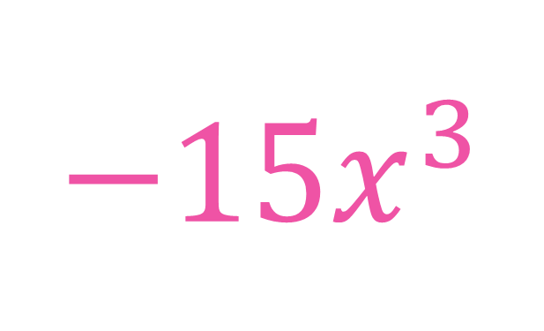
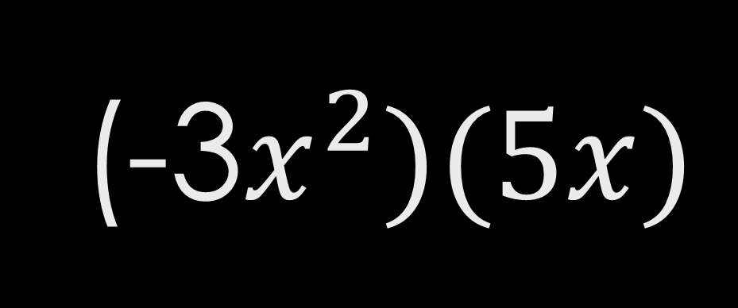
(-3$x^{2})(5x)$
$$−15x^{3}$$

Slide 3
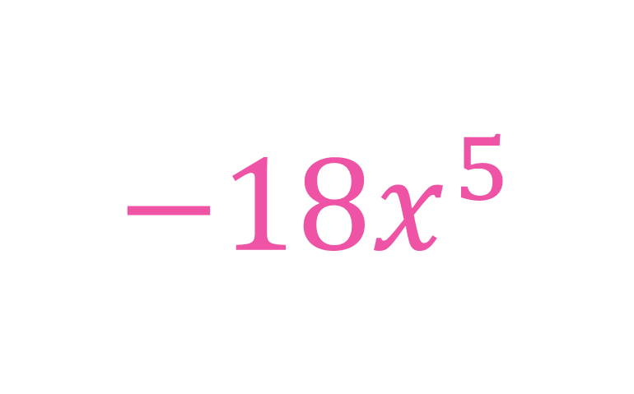
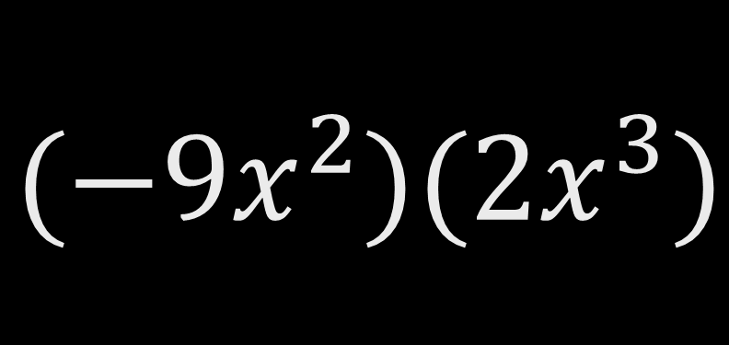
$$(−9x^{2})(2x^{3})$$
$$−18x^{5}$$

Slide 4
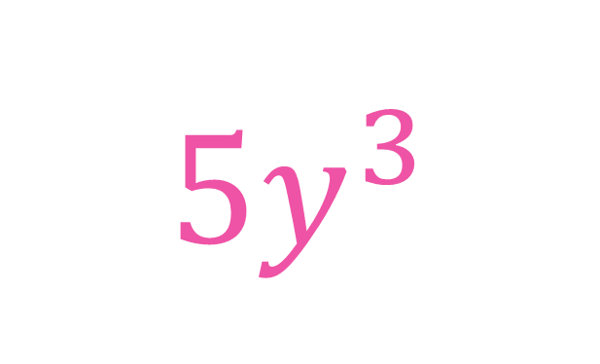
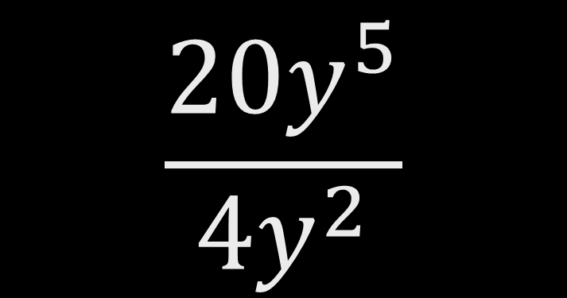
$$\frac{20y^{5}}{4y^{2}}$$
$$5y^{3}$$

Slide 5
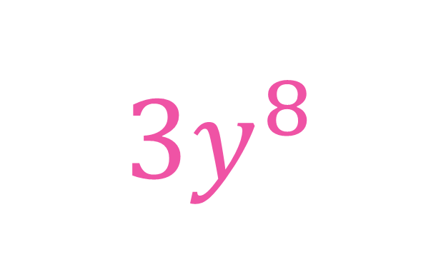
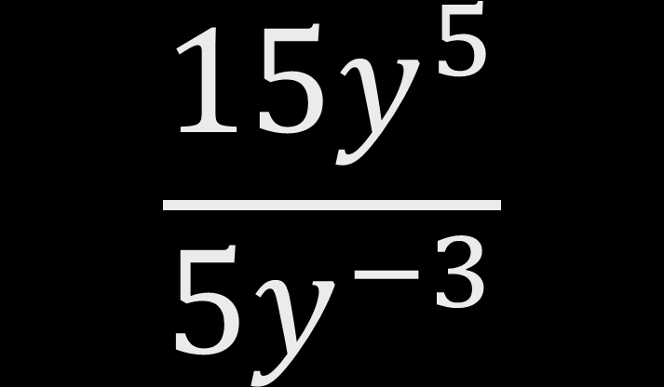
$$\frac{15y^{5}}{5y^{−3}}$$
$$3y^{8}$$

Slide 6
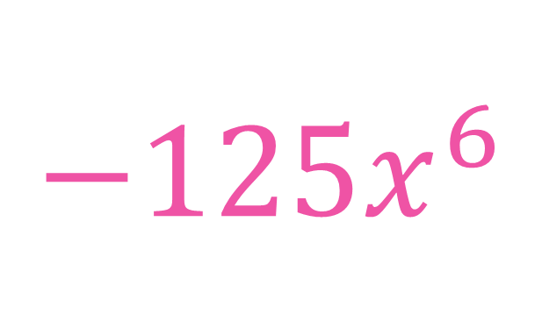
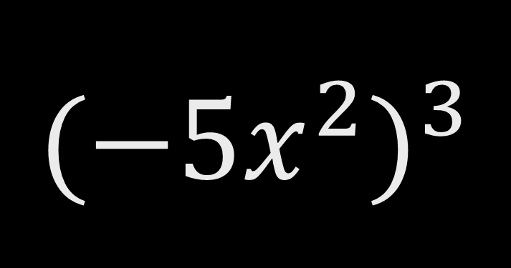
$${(−5x^{2})}^{3}$$
$$−125x^{6}$$

Slide 7
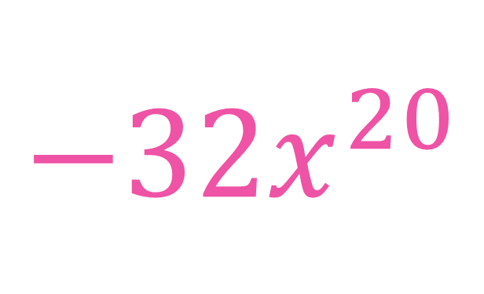
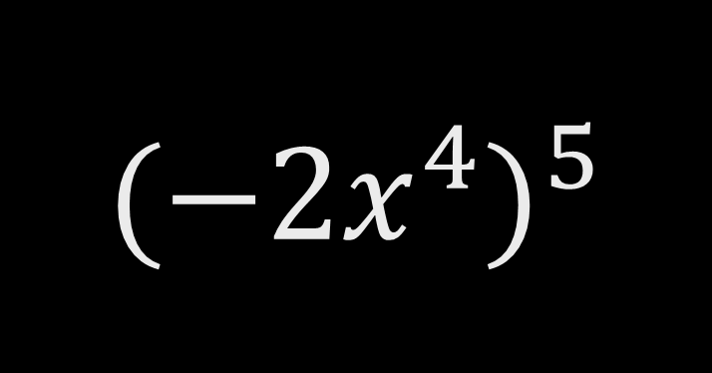
$${(−2x^{4})}^{5}$$
$$−32x^{20}$$

Slide 8

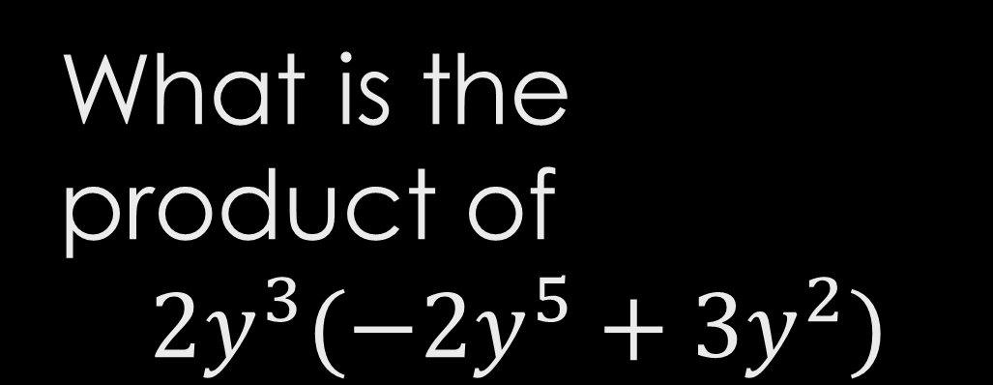
What is the product of
$$2y^{3}(−2y^{5}+3y^{2})$$
$$−4y^{8}+6y^{5}$$

Slide 9
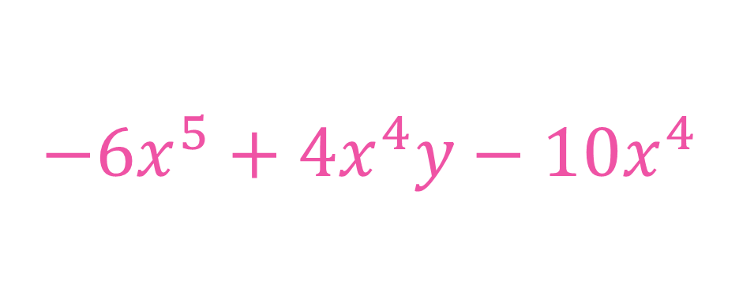
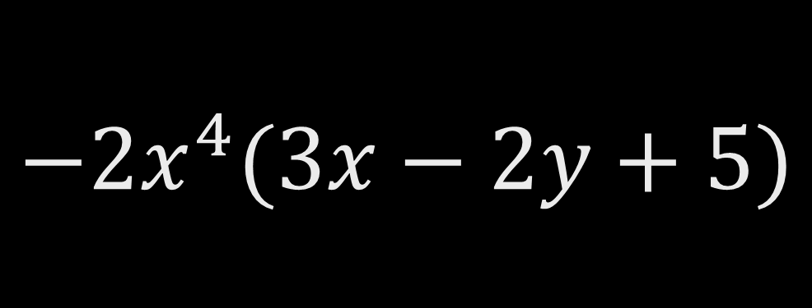
$$−2x^{4}(3x−2y+5)$$
$$−6x^{5}+4x^{4}y−10x^{4}$$

Slide 10
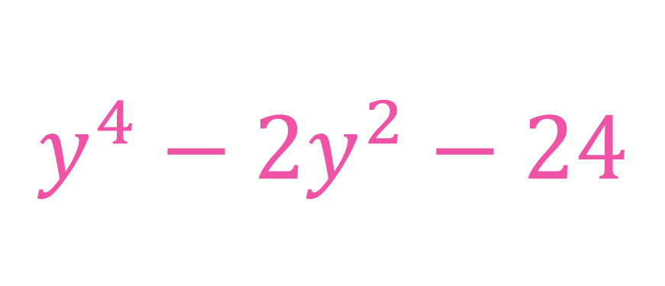
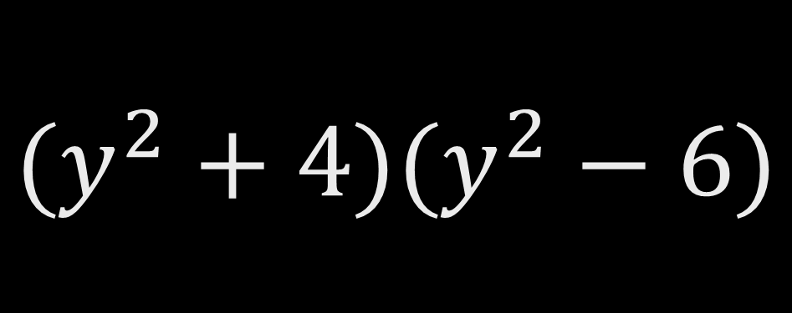
$$(y^{2}+4)(y^{2}−6)$$
$$y^{4}−2y^{2}−24$$

Slide 11

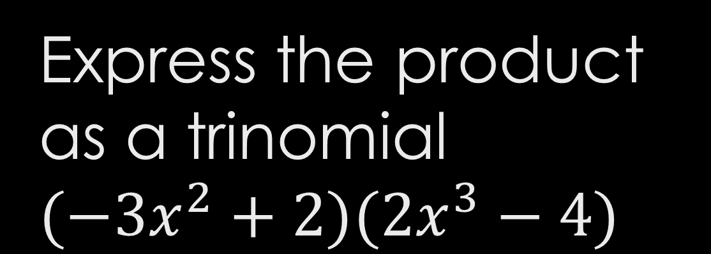
Express the product as a trinomial
$$(−3x^{2}+2)(2x^{3}−4)$$
$$−6x^{5}+4x^{3}+12x^{2}−8$$

Slide 12
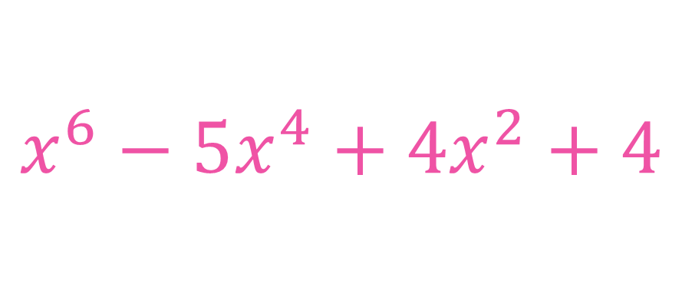

$$(x^{2}−2)(x^{4}−3x^{2}−2)$$
$$x^{6}−5x^{4}+4x^{2}+4$$

Slide 13
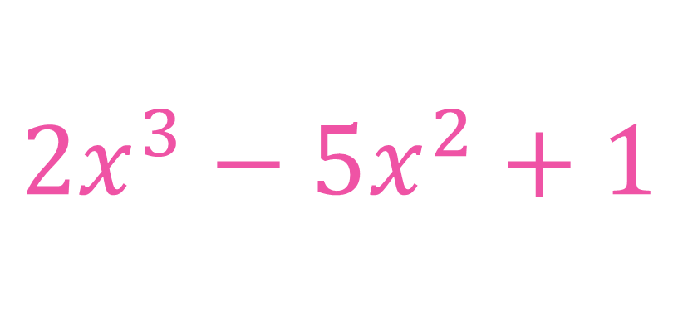

$$(x^{2}−2x−1)(2x−1)$$
$$2x^{3}−5x^{2}+1$$

